Slide 1

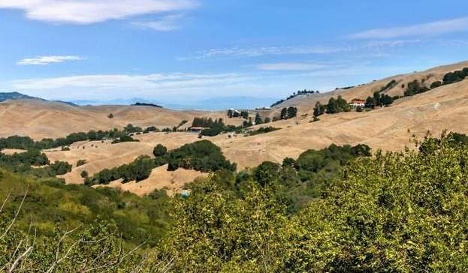



Bollinger Canyon Study Area General Plan Amendment and Rezoning Town Council Study Session
Town of Moraga
May 25, 2022

Slide 2
Context
Town is undertaking “Comprehensive Advanced Planning Initiative”
Includes:
2023-2031 Housing Element (required by State law)
Rezoning of key parcels
Focused General Plan Update
Phase 1: Amendments for internal consistency with Housing Element, and to meet State Safety and Circulation Element mandates
Phase 2: Update of remainder of General Plan
Bollinger Rezoning
Program-level EIR covering actions listed above

Slide 3
Work to Date on Bollinger Canyon
January 2022: “White Paper” provided planning context and zoning options
January 25: Neighborhood Meeting
February 9: Town Council Study Session
February 17: CEQA Scoping Session
Feb-May: Ongoing coordination with property owners, Police Department and Fire District
March-April: Drafting of new zoning designations/map and conforming General Plan amendments
This item addresses General Plan and zoning designations only—
there is no development application or “project” under consideration

Slide 4
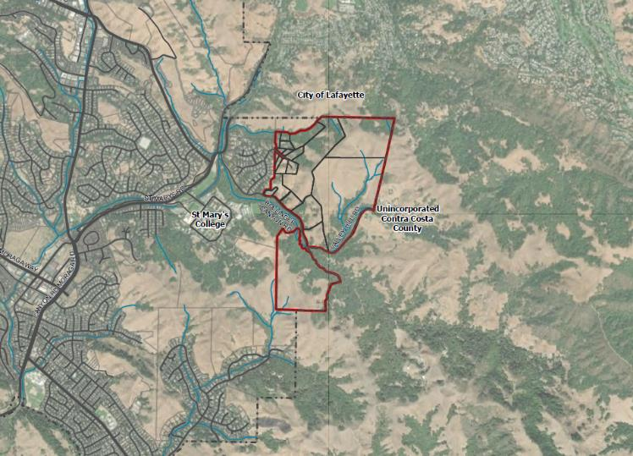
Study Area
RHEEM
CENTER
ROAD
MARY’S
ST.
BOLLINGER CANYON
MORAGA
CENTER

Slide 5
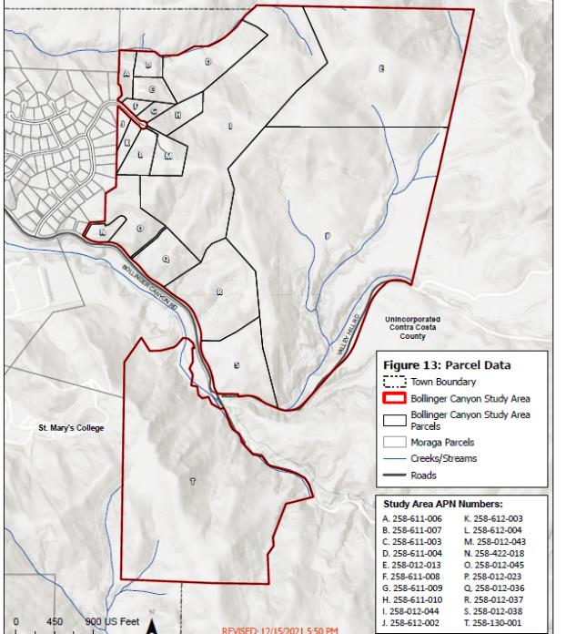
Study Area
423 acres
20 parcels
13 owners

Slide 6
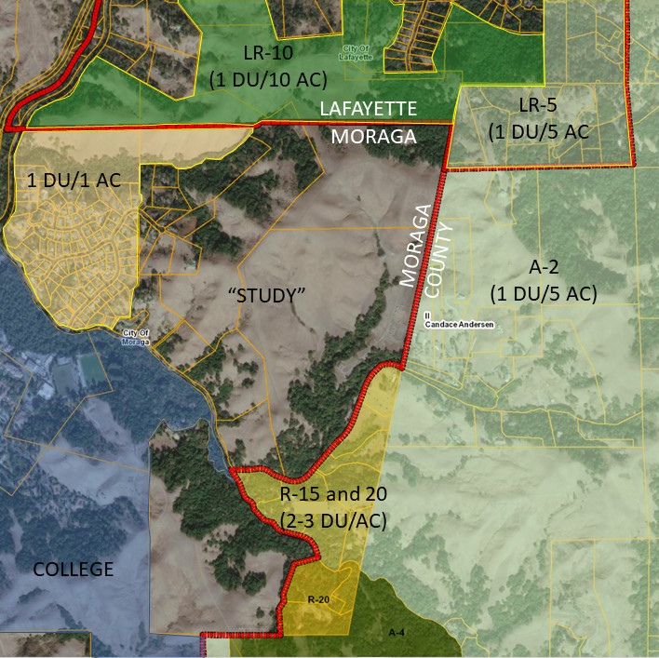
Current Zoning Context
General Plan: Agricultural Lands

Slide 7
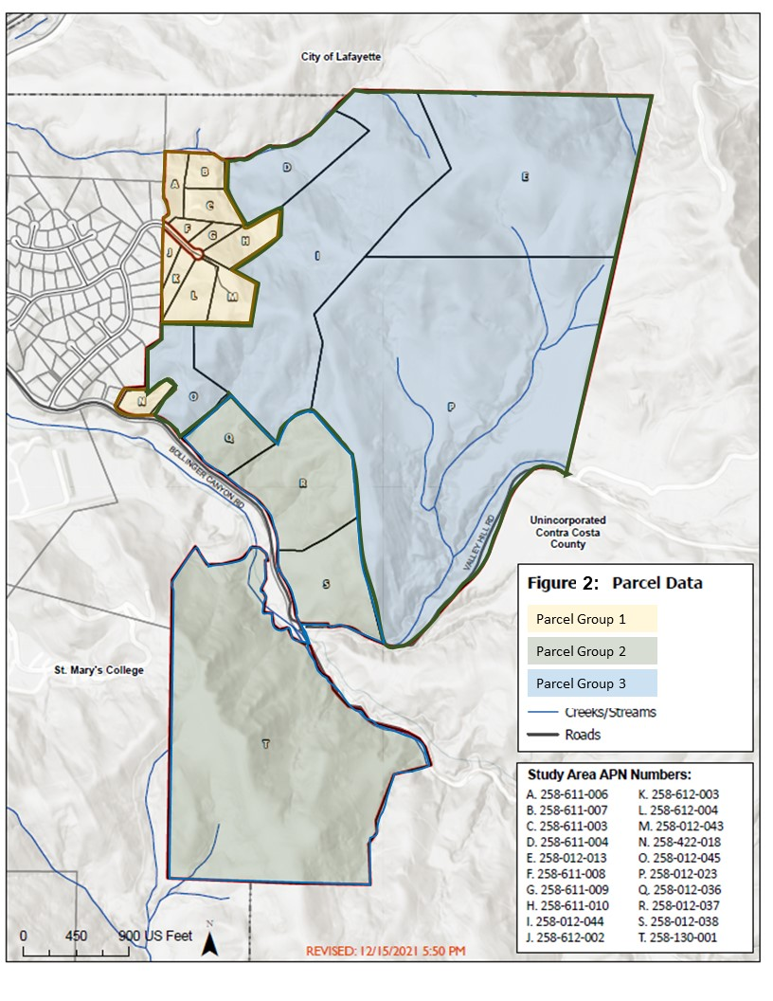
Existing Conditions
1
3
Land use,
parcel size, and ownership
suggest three parcel groups*
2
Subsequent property owner request to move to Parcel Group 3
* These are the initial groupings proposed in January. Boundaries have been changed to reflect property owner input

Slide 8
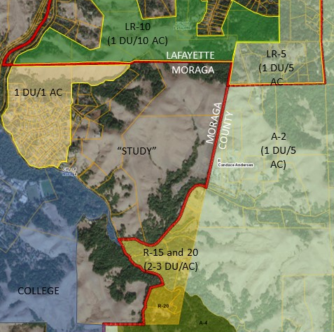
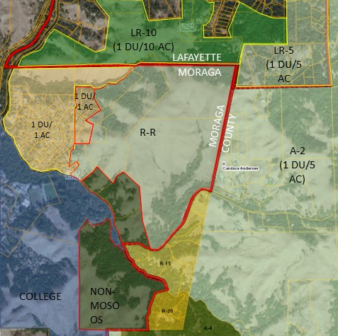
Composite Zoning Map, with Surrounding Area
EXISTING
PROPOSED

Slide 9
New Rural Residential Zone will apply to 270 acres
Intent: “To promote a rural character by providing for very low density single-family residential uses, agricultural uses, and preservation of the natural environment consistent with the General Plan”
Seven parcels
Maximum buildout with current parcel configuration is about 50 units*
* Excludes ADUs and JADUs; assumes the three lots smaller than 10 acres with existing homes are built out.

Slide 10
Uses and Standards
Permitted uses include single family homes, agriculture, dog care/training, other uses allowed in all residential districts under state law
5-acre min lot size (smaller lots allowed through clustering and Planned Developments, provided overall density is maintained)
Basic standards:
25’ setbacks
100’ street frontage
140’ lot depth/width
Site and development analysis required for PD or subdivision

Slide 11
Other Conforming Zoning Amendments
Deletion of references to “S” district throughout Code
Addition of references to “RR” district throughout Code
Allowances for animal keeping (provisions are similar to MOSO Open Space and Non-MOSO Open Space)

Slide 12
Definition of “Agriculture”
In response to public comment, staff proposed revising the definition of “Agriculture” to include processing
“Agriculture” means the tilling of soil, the raising of crops, horticulture, dairying, and the raising and managing of livestock, and any accessory buildings or structures for agricultural activities. including all uses customarily incident, and the necessary accessory uses for packing, treating or storing produce, provided that any such accessory uses shall be secondary to that of normal agricultural activities, but not including cannabis, slaughterhouses, fertilizer yards, bone yards, plants for the reduction of animal matter, or any other industrial use which may be objectionable because of odor, smoke, dust, or fumes.

Slide 13
General Plan Amendments
Deletion of “S” designation
New references to RR designation where appropriate
Deletion of Goal LU-6/Policy LU-6.1 on Study Area
Deletion of Implementation Measure for Study Area
Modification to General Plan Map (parallel to zoning designations)
Need for additional amendments has been identified—further changes will be made through Housing Element process and General Plan Update “Phase 2”

Slide 14
Public Input
Request to move two parcels at end of Joseph Dr (3.8 acres and 3.5 acres) from 1 DU/AC to RR
Concerns about limitations on ag processing and future of ag activities (from vineyard operators)
Largest landowner (186 acres) has requested 1 DU/ac designation
Concerns about traffic, safety and evacuation capacity (from neighbors on Valley Hill and Bluffs area)

Slide 15
Planning Commission Input (5/24)
Definition of “agriculture” needs modification to avoid subjective language
What is the threshold for “objectionable”?
Would the definition apply to existing activities?
Provide sufficient time for property owner input at public hearings
Address congestion and safety along St. Mary’s Road
Commission voted 5:0⁽*⁾ to forward staff recommendation to Town Council, with further changes to be made to definition of agriculture
* Five Yes votes, One absent, One recusal

Slide 16
Next Steps
Summer 2022:
Town Council review of Draft Housing Element (7/13/22)
Continued work on EIR for Comprehensive Planning Initiative
Continued work on General Plan Amendments
Continued communication with property owners
Fall 2022: Release of Draft EIR for Advanced Planning Initiative
Dec 2022: Final zoning and General Plan text provided for adoption

Slide 17
Thank You!
Town of Moraga
May 25, 2022
Town Council Study Session
Bollinger Canyon General Plan Amendment and Rezoning

Slide 18
Definition of “Agriculture”
In response to Planning Commission comments, staff is proposing further revising the definition of “Agriculture” as follows:
“Agriculture” means the tilling of soil, the raising of crops, horticulture, dairying, and the raising and managing of livestock, and any accessory buildings or structures for agricultural activities. including all uses customarily incident, and the necessary accessory uses for packing, treating or storing the produce, provided that any such accessory uses shall be secondary to that of normal agricultural activities, but not including cannabis, slaughterhouses, fertilizer yards, bone yards, plants for the reduction of animal matter, or similar agricultural processing facilities that are industrial in nature any other industrial use which may be objectionable because of odor, smoke, dust, or fumes.

